Slide 1

Personal Accountant
Personal Financing Possibilities: Are we wise or otherwise
Pinky and the Brain:
Awais Sultan, Erin K Pizzi, Jarrod T Meyer
Notes:
Good Afternoon. My problem pitch is on Personal Accountant

Slide 2

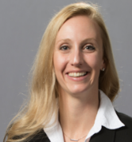

Pinky and the Brain
FOUNDER
Awais is a current Lead Architect for TOS and the brain child of this idea. He thinks problem analysis and then architecting accordingly is an art. So he calls himself an artist perhaps wrongly.
CO-FOUNDER / INTERVIEWER
Erin is Sr BL Regulatory Review Mgr. for Env & Soft Dollar CR Policy Coordination group of corporate and commercial banking. She is playing interviewer and researcher role here. She has very pleasant and colorful way of handling things and she brings energy to team. And the engine stops whenever she gets off.
LEAD RESEARCHER
Jarrod is Business Ops Analyst for Fund Services – Fund Accounting under Wealth MGMT & Investment SVCS business line. He is playing lead researcher role here. He thoroughly researches a domain and reads through associated articles.
Notes:
We call ourselves "Pinky and the Brain", but we are a group of three.

Slide 3
PROBLEM
Personal budgeting & accounting is tedious and imperfect
  Manual budgeting/ accounting is haphazard, time consuming and not dependable. It carries several issues with it including:
    Categorizing transactions to generate reports is laborious, in some cases professional help is needed which costs dollars.
    Budget overdrafts remain unnoticed, balancing overdrafts between budget categories requires a lot of manual self-management.
    Personal budgeting is something individuals complete on periodic basis at best.
    Some important cases/alerts related to taxes, budget, small business accounting.. including future projections remain unattended.
Notes:
Manual budgeting/accounting is haphazard, laborious and many times remain partial.

Slide 4


OPPORTUNITY / HYPOTHESIS
Customer Obsession
  By providing a more intuitive, automated (possibly AI enabled), top of industry method to manage personal budget & accounting that can be flexible, sort of providing a play area, to adjust to individual’s/customer’s need, that helps to make USBank more central to the lives of our customers.
  Essentially….
  Automate your budgeting
Notes:
There is a need of more intuitive and automated way for personal budgeting and accounting. A customer empathy space that USBank can fill.
A very important point to highlight here, is that though, there are other apps available in this domain, but they are rigid and cover to basic needs. Rather there is a need of an app, where users should be able to apply adjustments to fit to their need and can use it for wide range of accounting functions.

Slide 5
Value Propositions
Automate personal accounting.
Manage better or avoid following:
  Procrastination with budgeting
  Overspending
  Lack of personal savings and investments
  Missed opportunities such as tax deductions…
Care about family and friends.
Notes:
A good financial app can help us manage overspending and improve on personal savings/ tax savings and investments. And save on time to do better things in life.

Slide 6
CUSTOMERS
Financing possibilities for everyone; the problem doesn’t discriminate and neither does our solution
Primary = Any depository customer of US Bank.
  A customer can be one person or joint accounts.
  A customer can be somebody who is running his business transactions through US Bank accounts
  Small Businesses, companies.
Secondary = Wealth Management, Investment accounts
  US Bank wealth management and investment services clients.
Notes:
Customers of this app will be any US Bank depository customer.

Slide 7
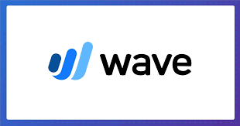



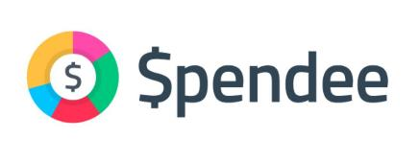










MARKET
Notes:
There are many competitors in this domain. Some are mentioned here.
There are other competitors in this domain however, as mentioned earlier, we are looking into providing wider coverage for accounting needs on top of which users can do adjustments. After all one size does not fit all.

Slide 8
MARKET
 | Budget | Tax | Investment | Loans
Dependents | * | * | * | *
Students | * | * | * | *
Young Professionals (<30) | * | * | * | *
Professionals
Retirees
Small Business Owners
Head of House Hold
Single filer
Joint filer
* Only 24 percent of millennials demonstrate basic financial literacy
 | More Likely
 | Likely
 | Less Likely
Notes:
The table here is presenting different user segments on left and different accounting functions on top, to show who needs what the most, using colors Green, Yellow and then Grey from Most to least.

Slide 9
CURRENT
Journey
Notes:
I am going to present 5 journey maps to show multiple scenarios. First three will be current journey maps

Slide 10






SCENARIO:
Mr. and Mrs. Joe want to arrange their banking transactions to gain comparison reports between original budget vs actual expenses.
GOALS & EXPECTATIONS:
Mr. & Mrs. Joe want to perform budgeting without going through too much pain.
Mr. & Mrs. Joe want to prevent errors in calculations.
Mr. & Mrs. Joe want to do budgeting following consistent intervals.
After 1 hour
Mrs. Joe: We just did couple of months, we have several more months to look into. Why we don’t do it more regularly. Its just too much work now.
Mr. Joe: We have more bank accounts to look into. I also have to apply some calculations to get some numbers. Its so frustrating.
Mr. Joe: Let’s try a faster way this time. You just scan through transactions and I keep noting them down and will mark their category.
Mrs. Joe: I am not sure if it is any different than before. But let’s just start, I really want to get over this.
After 2 hours:
Mr. Joe: You know what, let’s do remaining work including calculations and evaluating reports tomorrow.
Mrs. Joe: Yes sure. I just hope somebody else does this for us. By the way tomorrow never comes.
Tomorrow never comes.
Mr. Joe: Let’s do budgeting today. I am opening bank site to go over transactions.
Mrs. Joe: Ok I will help you, but you have to find a better way for this. Its so tiring.
1
4
2
5
3
Opportunity:
- Manual budgeting is so laborious that it requires an extra effort to setup the mood, sit down and then work on it.
Opportunity:
Manual budgeting is so frustrating that it becomes difficult to be regular.
Manual budgeting has errors, require time to doublecheck/ fix errors.
Opportunity:
- Many times budgeting remains partial, planning remains partial, retrospection remains partial.
Notes:
In current journey maps red bars are pain points. In this first journey map a scenario is presented, where a family is trying to do their budget. After spending several hours, frustration creeps in, they start scratching their heads and eventually they decide to leave it for tomorrow. And tomorrow never comes.

Slide 11




SCENARIO:
Its tax season and Michel wants to file his tax return through tax consultant.
GOALS & EXPECTATIONS:
Michael needs an optimal way to provide data/spread sheets to his tax consultant to prepare his tax return.
After few hours, he thinks he has something he can share with his tax consultant. However for some transactions he was no sure if they count as business expenses or not or if they were deductible or not. But he wants his tax consultant to review his spread sheets first.
Michael’s tax consultant asks him to re-work on his spread sheets. Tax consultant guides Michael how to properly identify business expenses and deductibles among other things.
He is looking through his bank accounts. His transactions are either personal or belong to his small business. He has to extensively work to note down his small business transactions as business expenses are tax deductible.
Michael has to work now on spread sheets again. Michael is also thinking about paying tax consultant additional fees, so that tax consultant can do his spread sheets.
Michael is gasping, he is due to give spread sheets to tax consultant and today he has to do it. He has to take some time out and go through this laborious exercise
1
4
2
5
Opportunity:
- Gathering information to prepare for filing tax return like creating spread sheets to share with tax consultant is an aching exercise.
3
Opportunity:
With not enough prior information, Michael has to go through this painful exercise multiple times.
Opportunity:
With not enough knowledge, we are not sure what we are doing is going to work.
Opportunity:
For personal accounting we have to work like bots or pay more to get more help from specialist.
Notes:
In this scenario a guy named Michael is trying to create spread sheets, which his Tax consultant wants from him, to file his tax return. After pains-takingly creating spread sheets, he share them with his tax consultant. But his tax consultant asks him to do some changes and Michael has to work again on his spread sheets.

Slide 12



SCENARIO:
Michael is using an accounting app MINT to do his budgeting and taxes.
GOALS & EXPECTATIONS:
Michael wants to leverage automation/software for his budgeting and other accounting support.
Michael started looking into other apps. His worst nightmare is that he has to do most of his accounting related functions manually.
There may or may not be an app out there to fully support Michael. Some apps are not free. Also Michael is not sure how good a researcher he is and then research has its own fatigue. He wonder’s if his bank has suggestions.
Michael finds no way to customize the categorization of transactions or customize the reports. He feels that default placement and reports are very basic and does not serve his purpose.
He tries to find support for managing his taxes and preparation of tax return but finds that MINT is only for money management from budgeting perspective.
Michael looks into the way his bank account transactions are categorized in MINT, however he is not satisfied with default placement and wants to update it.
1
4
2
5
Opportunity:
- Lack of customization for transactions’ categorization and reports that can be auto applied for future. After all one size does not fit all.
3
Opportunity:
At best MINT can be used partially for basic categorization of transactions for budgeting and a lot else still remains manual.
Opportunity:
Michael wants to automate other accounting related functions, not just budget.
Opportunity:
US bank can serve it’s customers better by serving in personal accounting area. It can help US Bank become customer’s first choice for personal banking.
Notes:
In this third Scenario, Michael is using an app called MINT. But he finds out that he can only do budgeting through MINT and also that to a basic level. He can't apply adjustments to any budget categories & transactions’ placements, nor he can create spread sheets needed for tax return. Michael eventually finds out that he can't complete any of the accounting functions through this app. After all one size does not fit all.

Slide 13
FUTURE
Journey
Notes:
Last two journey maps are future journey maps to show the comparison, for what is possible in future versus current.

Slide 14





SCENARIO:
Mr. and Mrs. Joe want to arrange their banking transactions to gain comparison reports between original budget vs actual expenses.
GOALS & EXPECTATIONS:
Mr. & Mrs. Joe want to perform budgeting without going through too much pain.
Mr. & Mrs. Joe want to prevent errors in calculations.
Mr. & Mrs. Joe want to do budgeting following consistent intervals..
Mrs. Joe: The great think is that we are able to mange our budget on monthly basis and there are no slippages.
Mr. Joe: And we scratch our heads and manually do it no more.
Mr. Joe: Don’t you think we should sub-categorize our outing expenses into dining and shopping. The good thing is I do this one time and app remembers it for future
Mrs. Joe: It’s a good idea.
Mr. Joe: We over-budgeted on grocery since quite a few guests visited us this month but we spend less on outing so I am going to record this accordingly in the app.
Mrs. Joe: Yeah this way carried over expenses can be adjusted accordingly.
Mr. Joe: Let’s do our budget today
Mrs. Joe: What are you looking me for? use the Personal Accountant app to do the magic.
Mr. Joe looks into the app and looks at the way the transactions are categorized and then looks into reports and see how they performed versus what they originally planned.
3
5
2
1
4
Value Proposition:
Families can spend more time on budget analysis and better self- management.
Rules are customizable i.e., self driven rules can be created for transactions’ placement.
Custom reports are possible.
Value Proposition:
Budgeting can occur following targeted timeframe within consistent periods. In fact it can happen on demand.
Manual painful work is automated.
Value Proposition:
Calculations can be applied to get an idea how to recover or stay within budget.
Errors associated with manual calculations are prevented
Value Proposition:
- With the app, its so easy to see how you are doing budget-wise.
Value Proposition:
- With the app all bank transactions are auto-categorized and reports can be analyzed.
Notes:
Green bars here are gains/value propositions. For example, here family wants to do their budget, which the app does it for them automatically. They can apply some adjustments on top of it. This enables them to do their budget on demand.

Slide 15



SCENARIO:
Its tax season and Michel wants to file his tax return through tax consultant.
GOALS & EXPECTATIONS:
Michael needs an optimal way to provide data/spread sheets to his tax consultant to prepare his tax return.
Michael feels relieved that the app has automated most of his personal accounting functions.
Michael looks into updated reports. They look good to him and generate spread sheets through the app that he wants to share with his tax consultant
Tax consultant reviews the reports and then consume them to file tax return for Michael. Michael feels empowered, the app has shaped up to match his needs.
Michael opens the Personal Accountant app and looks at Tax reports, including business expenses that are deductible, personal deductibles like mortgages.
According to his tax consultant the lunches he had onsite is a business expense. He adds that rule in the app.
3
5
2
1
4
Value Proposition:
Michael likes the fact that with the app he is not just doing taxes, but budgeting, investments etc. as well. This provides the complete package. At the end of the day all of them are connected.
Value Proposition:
With customization available for example custom transaction’s categorization, the app shapes up to individual need. After all, one size doesn’t fit all.
Value Proposition:
Spread sheets, reports can be generated to share with specialist like spread sheets that are needed by tax consultant to file tax return can be generated.
Value Proposition:
- Michael likes that a lot of preparation for tax return filing is automatically done by app and manual work is avoided.
Value Proposition:
- Michael loves the fact that he can apply custom rules and can apply his tax consultant feedback.
Notes:
In this scenario Michael is able to create spread sheets automatically that are needed for his tax return. He can also apply his tax consultant feedback and re-generate the spread sheets.

Slide 16
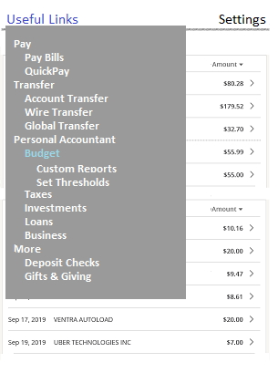
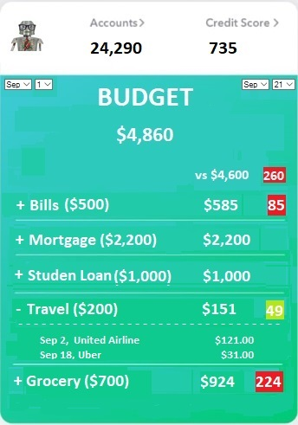
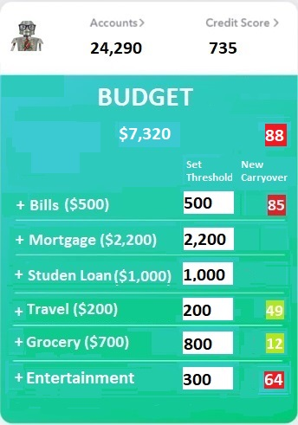
Minimum viable prototype
Personal Accountant App – How we are doing financially
Notes:
- Now, I am going to show Minimum Viable Prototype for the app.
- The idea is that at bank accounts’ site, customers can be offered with “Personal Accountant” features like Budget, Taxes, Investments, Small Business.
Customers can select one, for example Budget. This brings them to the second screen where they can see how much they have spent within a date range versus planned. They can also see category wise breakdown.
They can also see if they over-spent (in red), or under-spent (in green), overall or category wise.
In the third screen, customers can set spending thresholds per category. That is where they can plan their budget. They can also see how realistic is their new plan.

Slide 17
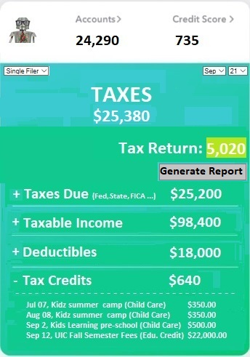
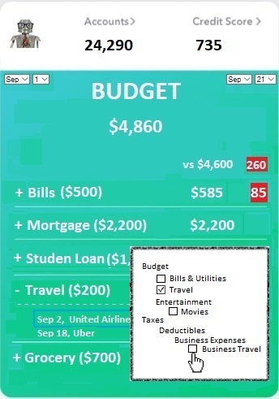
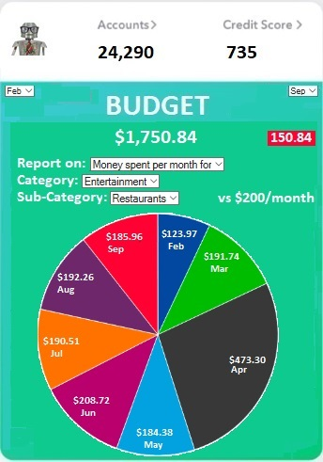
Minimum viable prototype
Personal Accountant App – How we are doing financially
Notes:
This app will not only help in budgeting, but will provide a complete package to customers for personal accounting, which I have seen missing in other apps in this domain that are mostly focusing on budget.
For example here, users can do their taxes as well. Users can see how much tax return they can possibly get for the current year. They can see how much taxes have been withheld, how much is due so far, how much and what transactions are deductibles, and then what are Tax credits they are eligible for.
They can expand category to see individual applicable transactions.
One unique and deciding factor for this app is its play tool. For example, as you can see in the second screen, users can adjust transactions’ categorizations among other things. This makes app fit to customers’ needs. I have seen in other budgeting apps that users can’t do adjustments as they wish to do, thus those apps stay at a basic level and are not entirely useful to customers.
Users can also create custom reports. In the third screen customer has selected to see his monthly expense report for category: entertainment and sub-category: Restaurants.

Slide 18
Value Additions
Let the bot do it for you
Value additions:
  Saves time.
  AI powered.
  Saves customer’s money.
  Encourage customer obsession.
  Retain and gain customers.
  Can help make USBank customer’s primary bank.
  New product for US Bank. Protection of our customers.
  Gain competition advantage
  Complete financial accountancy package
  Fits to customer's need.
  Gain superior insights
Notes:
This AI powered app can help customers save on time so that they can spend quality time with family, will help customers get financially organized and save on their money. This will also make US bank focus on financial growth of our customers and thus makes US bank central to lives of our customers.
Although there are others external apps available in this market but this will still be new idea within US Bank for our customers. Several other banks have introduced or are introducing pretty soon, similar features on their sites like Chase, Citi, PNC bank etc. Its time for us to focus on this domain as well that will provide protection to our customers.
This app will provide not only budgeting solution but also other accountancy related features like Taxes, Investments etc. On top of that, it provides a play tool to our customers to fit to their need. Our survey indicated, people will like to have this feature. Again, after all one size does not fit all.
Very importantly, this app will provide superior insights by organizing customers’ financial transactions.

Slide 19
Next Steps
Opportunities are endless
App provides wealth of organized information (superior insights).
Information can be used to build customer obsessed features.
Information can be fed to features focusing customer spending habits.
Information can be fed to wealth building ideas (Economist)
  Wealth building for customers
  Wealth building for small businesses
Notes:
With the wealth of organized information gained through the app, we can build features that are focused on financial health of our customers and/or build features following customers’ spending habits.
This app can combine with wealth building ideas. Like how we are doing financially today versus how should we do it tomorrow. Wealth building apps can be for customers and businesses.

Slide 20
Research Continues…
Some numbers we are looking for:
  How many US Bank customers (depository account holders, credit card holders ….) use competitor products like MINT?
    How many of them will like to use US Bank offering in this domain instead?
  How many US Bank customers who are not using any accounting app will like to use an accounting app offered by US Bank?
Notes:
There are still some numbers we are looking for. Our research will continue onto next phases.

Slide 21
Bibliography
Good Articles on the subject:
  US Bank automated investing
  A class at UC-Berkeley
  Only 24 percent of millennials demonstrate basic financial literacy
  Money Habits
  The hidden cost of free financial apps
  US Bank Possibility Index.
  Only 18% of Americans actively contribute to an IRA
Notes:
Here is the list of articles that provide good information and data points relevant to personal accounting.

Slide 22
HE WHO WILL NOT ECONOMIZE
WILL HAVE TO
AGONIZE.
Notes:
I am pretty sure many of us will agree “IF we don’t economize we will agonize”.

Slide 23
Questions & Answers
HE WHO WILL NOT ECONOMIZE WILL HAVE TO AGONIZE.
Notes:
This brings me to end of my presentation. Thank you.

Slide 24
Appendix
Additional Screens to follow……….

Slide 25
HUNCH
There are a few existing systems that do part of the job
Our team suspects that often times procrastination with budgeting leads to overspending, a lack of personal savings and investments and missed opportunities for tax deductions. Ignorance is not bliss.
Essentially...
Automate your budgeting
Notes:
HUNCH is "Our team suspects that often times pro-crasti-nation with budgeting leads to overspending, a lack of personal savings and investments and missed opportunities for tax deductions. Ignorance is not bliss."

Slide 26
Value Additions
Let the bot do it for you
Value additions:
  Auto-placement of transactions into categories for budget, taxes, investment….
  Automation of personal accounting functions.
    Budget: Category thresholds, overdrafts, overdraft coverage, carried over expenses
    Tax management: Recording deductibles, business expenses, reports to prepare for tax return
    Investment: Suggestions, Connect to USBank automated investor, recording invested vs profit.
  Produce reports to share information with specialist.
    For example spread sheets to share with tax consultant to file your tax return
  One size does not fit all so provide your size.
    Add custom rules to categorize transactions
    Customize reports.
    Run reports, calculations to analyze different scenarios.
  Financially organize yourself as you always hoped for.
  Protect yourself from missing deadlines, overdrafts and facing fines.
  Receive important alerts like threshold’s breached etc.
  Can help make USBank customer’s primary bank.dd
  Use organized information to build wealth building products for customers.

Slide 27
Additional Research Items
USBankPossibilityIndex.pdf
https://www.makingsenseofcents.com/2018/04/money-habits.html
  2. Average percentage of budget categories.
    Have you ever wondered what the average person spends in each category?
    32.9% goes towards housing.
    17% goes towards transportation.
    12.5% goes towards food.
    11.3% goes towards insurance.
    7.8% towards healthcare.
    5.1% on entertainment.
    3.3% on clothing.
    3.2% on cash contributions.
    2.3% on education.
https://money.usnews.com/money/blogs/my-money/articles/the-hidden-cost-of-free-financial-apps
  Mint, one of the most popular budgeting apps, uses a combination of revenue streams. The app manages your personal finances, from budgeting to bill payment to managing your bank accounts. It runs targeted ads based on you finances, receiving referral payments from the merchants with which it has partnerships. For a fee, Mint offers a credit-monitoring service. While it doesn't sell your data, the insights and trends it has access to from its user base have value. This anonymous aggregate data it does sell.
https://www.fool.com/retirement/2017/03/31/10-incredible-financial-statistics-that-sum-up-the.aspx
  7. Only 18% of Americans actively contribute to an IRA
    It's completely understandable not to use an IRA if you have an excellent retirement plan through your employer, such as a 401(k), that you contribute to on a regular basis. However, 25% of people who don't have an IRA said they simply don't know enough about these accounts, while 46% said they don't have the money to save. However, you may be surprised at how easy it can be to learn about and open an IRA, and how little money you need to get started.

